Slide 1
Machine Learning
For Market Analytics

Slide 2
Learning Objectives
Understand fundamentals of machine learning techniques and their use in analytics
Discuss different applications of machine learning in market analytics
Frame problems of market analytics as data-driven learning
Discuss recent advances in machine learning and artificial intelligence including applications

Slide 3
Lesson Outline
1. Introduction to Machine Learning and applications in Marketing
2. Fundamentals of Market Segmentation
3. K-means Clustering algorithm for segmentation
4. Marketing Mix Modelling
5. Regression for Marketing Mix Modelling
6. Demand Forecasting and time series modelling
7. Customer behaviour analysis and classification

Slide 4
Chapter 1
Introduction to Machine Learning and applications in Marketing

Slide 5
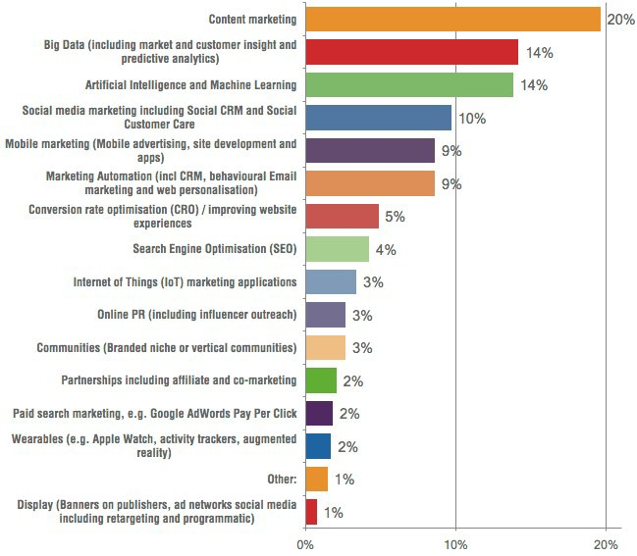
Lesson Outline
What is the single marketing
Activity that will make the
Largest commercial impact
In your business ?
https://www.smartinsights.com/digital-marketing-strategy/10-marketing-trends/

Slide 6
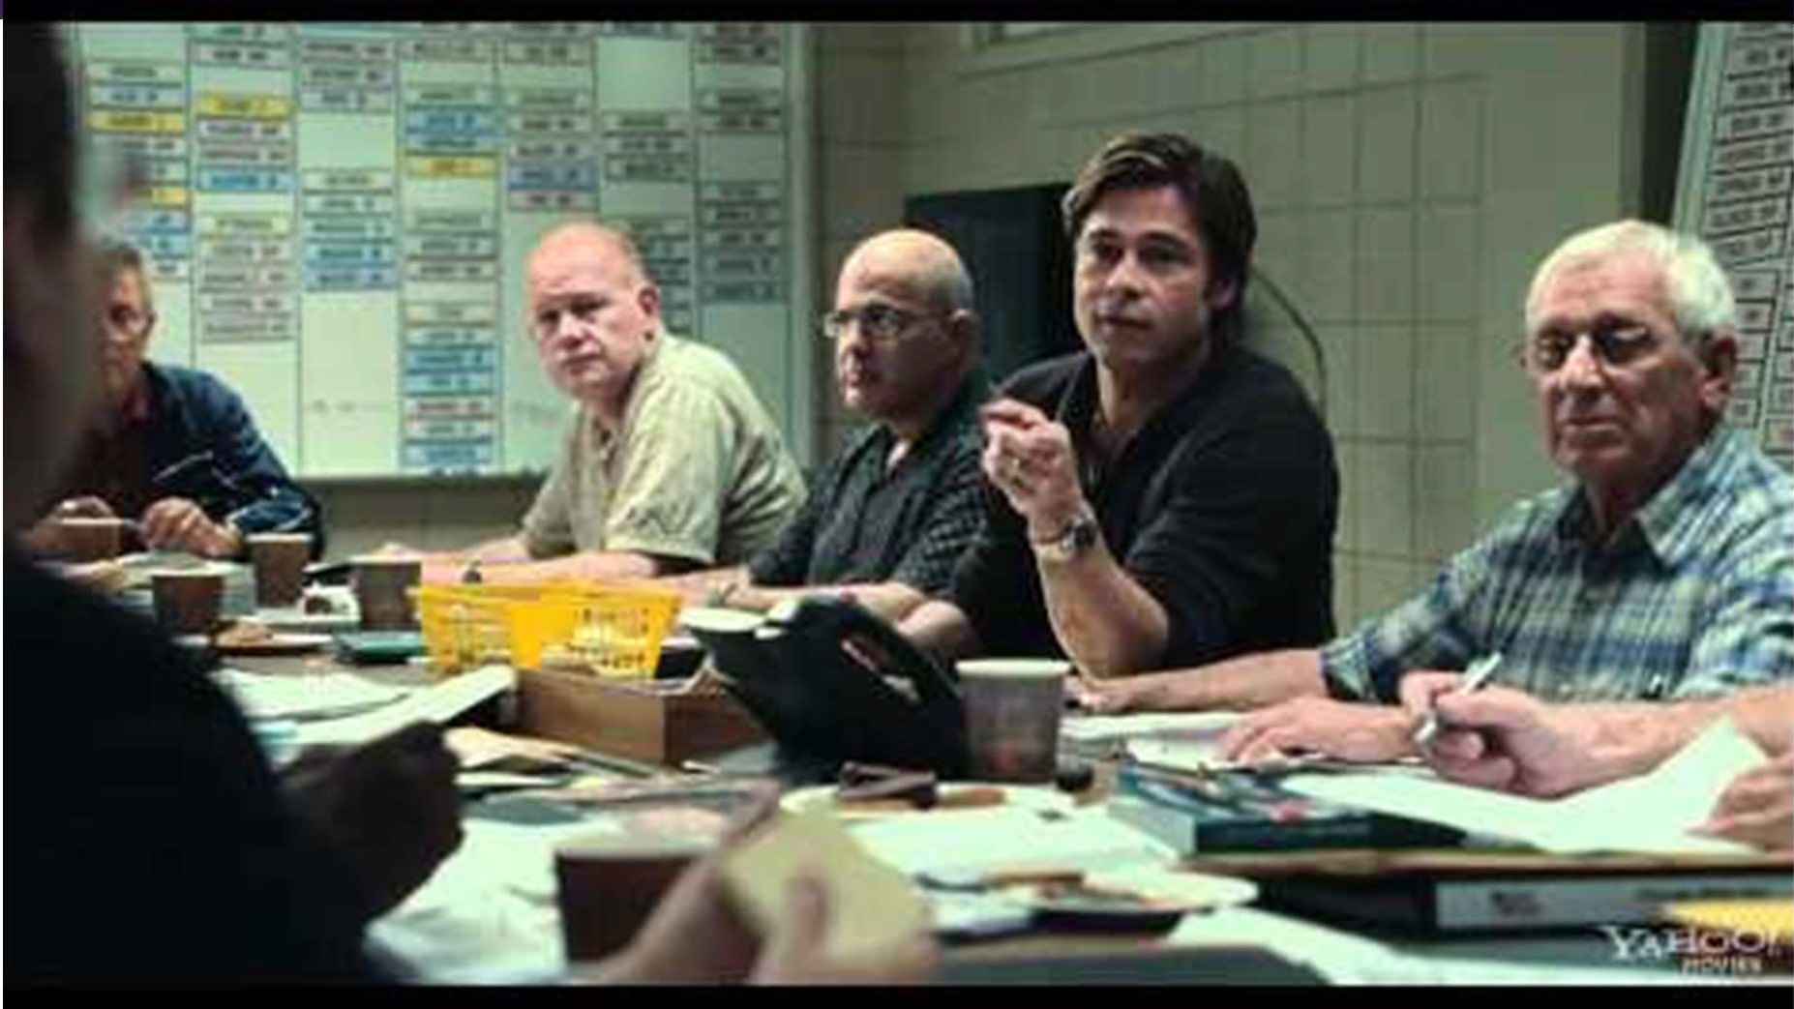
Analytics In Business Decision Making
https://www.youtube.com/watch?v=AKXKkeLQWac

Slide 7
Applications of ML in Market Analysis
Market Segmentation - Identifying different types of customers / product preferences
Marketing Mix - knowing the right mix of marketing efforts
Demand Forecasting - Understanding new needs, sales demands
Customer Behaviour Analysis - Understanding customer journey

Slide 8
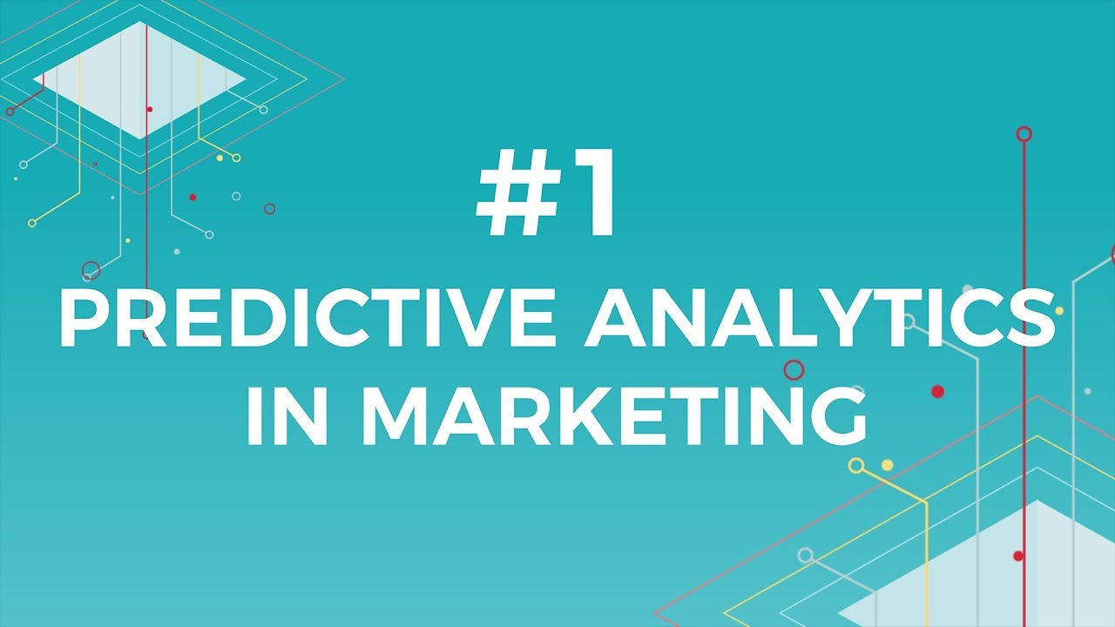
Analytics In Marketing
https://www.youtube.com/watch?v=uk82DHcU7z8

Slide 9




The Need for Machine Learning In Marketing Analytics
Customer Behaviour Analysis
Marketing Mix
Market Segmentation
Demand Forecasting
Object Tracking
Body pose estimation
Event Detection
Predictive Analytics
Recommenda tion Systems
Hidden Markov Models
Time Series Analysis
Neural Networks
Tensor Decomposition
Agent Based Modelling
Random Forests
Density Estimation
Regression
Classification
Clustering

Slide 10
Goal Of Machine Learning
Objective: - Explain an unknown system based on observed data and use the explanation to predict future outcomes
Past Observations - data points
Explanation (Model) - function
Learning - function estimation (from data)
Prediction
– using the model to predict new inputs

Slide 11
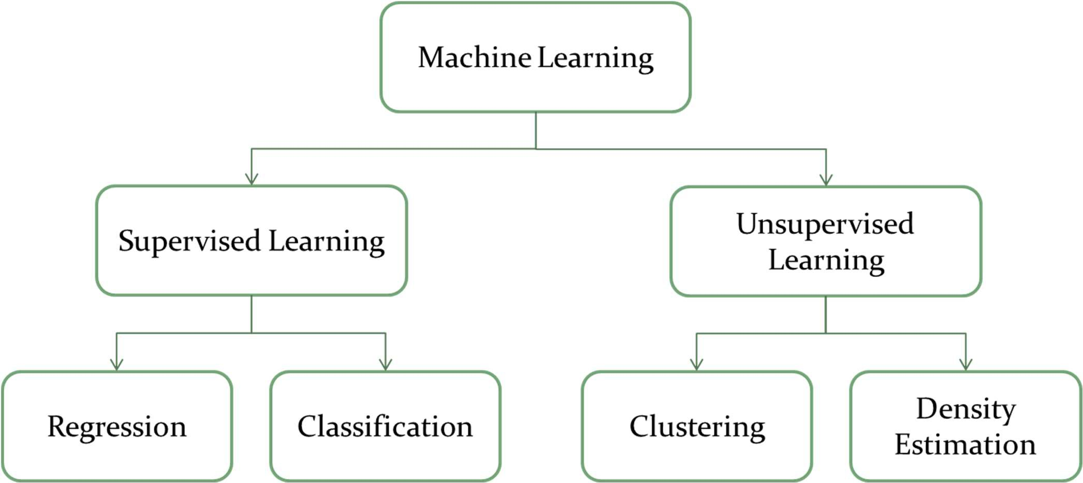
Machine Learning Algorithms

Slide 12

Machine Learning Algorithms
Classification:
Classification is a process of finding a function which helps in dividing the dataset into classes based on different parameters. In Classification, a computer program is trained on the training dataset and based on that training, it categorizes the data into different classes.
Regression:
Regression is a process of finding the correlations between dependent and independent variables. It helps in predicting the continuous variables such as prediction of Market Trends, prediction of House prices, etc.
The task of the Regression algorithm is to find the mapping function to map the input variable(x) to the continuous output variable(y).
https://www.javatpoint.com/regression-vs-classification-in-machine-learning

Slide 13
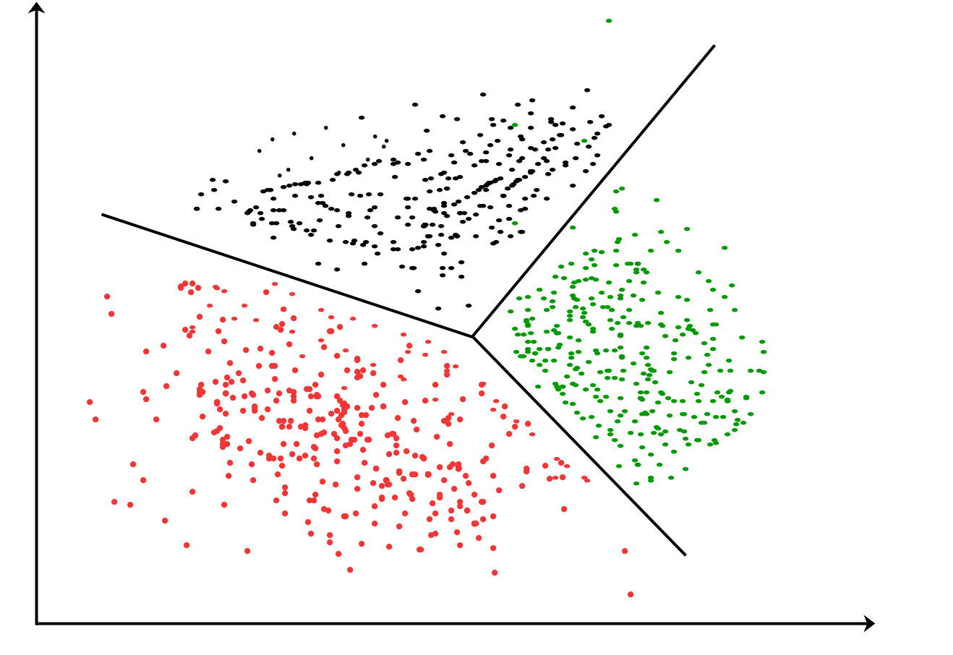
Machine Learning Algorithms
Clustering:
Clustering is the task of dividing the population or data points into a number of groups such that data points in the same groups are more similar to other data points in the same group and dissimilar to the data points in other groups. It is basically a collection of objects on the basis of similarity and dissimilarity between them.
https://www.geeksforgeeks.org/clustering-in-machine-learning/

Slide 14
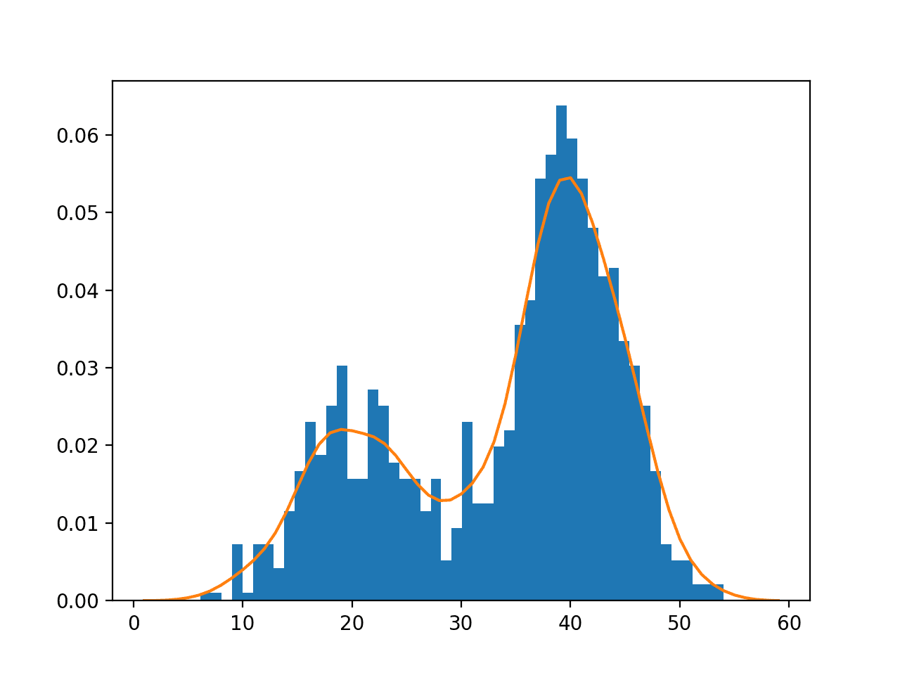
Machine Learning Algorithms
Density Estimation:
Probability density is the relationship between observations and their probability. Some outcomes of a random variable will have low probability density and other outcomes will have a high probability density.
A great way to estimate whether the data is highly clustered together or not and histogram plots are commonly used to calculate the probability density estimation of a data sample.
https://machinelearningmastery.com/probability-density-estimation/

Slide 15
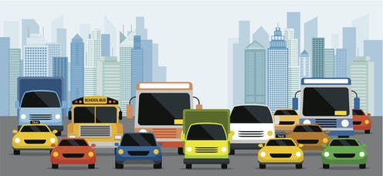
How many classes of vehicles are there in the photo ?

Slide 16
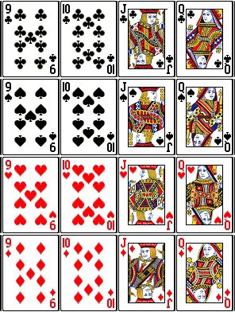
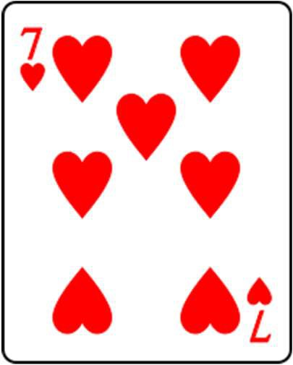
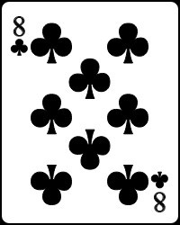
Which class does the each new card belong to ?
Class 1
Class 2
Class 3
Class 4
Card 1
Card 2

Slide 17
Which class does the each new card belong to ?
Class 1
Class 2
Class 3
Class 4
Card 1
Card 2

Slide 18
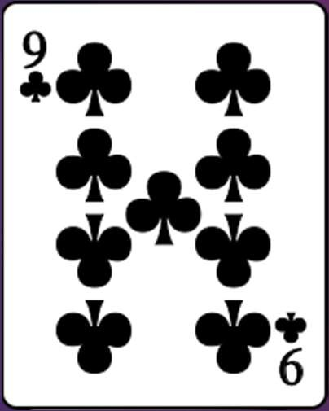
Which class does the new card belong to ?
Which class does the new
Card belong to ?
Class 1
Class 2
Class 3
Class 4

Slide 19
Which class does the new card belong to ?
Which class does the new
Card belong to ?
Class 1
Class 2
Class 3
Class 4
Class 1

Slide 20
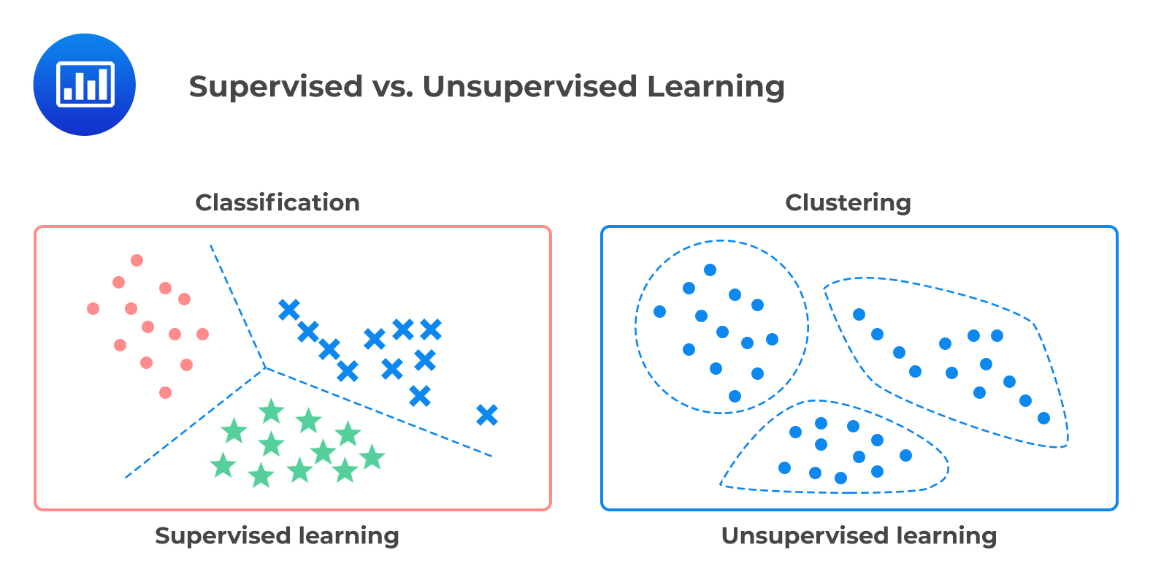
Supervised Vs Unsupervised Learning
In supervised learning, the output labels are provided for the examples which are used to train the machine and get the desired outputs
algorithms learn to predict the output from the input data
In unsupervised learning no output datasets (labels) are provided.
algorithms learn to deduct structure from the input data
https://analystprep.com/study-notes/cfa-level-2/quantitative-method/supervised-machine-learning-unsupervised-machine-learning-deep-learning/

Slide 21
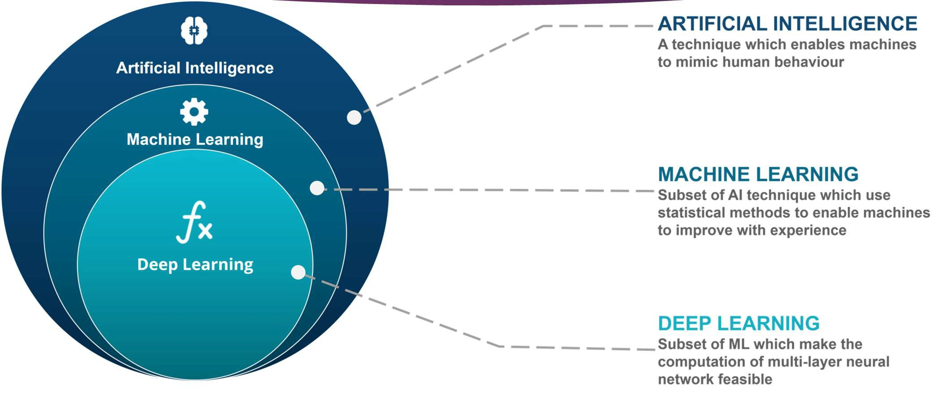
Machine Learning & AI

Slide 22

What is Artificial Intelligence
At its simplest form, artificial intelligence is a field, which combines computer science and robust datasets, to enable problem-solving. It also encompasses sub-fields of machine learning and deep learning, which are frequently mentioned in conjunction with artificial intelligence. These disciplines are comprised of AI algorithms which seek to create expert systems which make predictions or classifications based on input data.
https://www.ibm.com/cloud/learn/what-is-artificial-intelligence

Slide 23

What is Machine Learning
Machine learning is a branch of artificial intelligence (AI) and computer science which focuses on the use of data and algorithms to imitate the way that humans learn, gradually improving its accuracy.
https://www.ibm.com/sg-en/cloud/learn/machine-learning

Slide 24
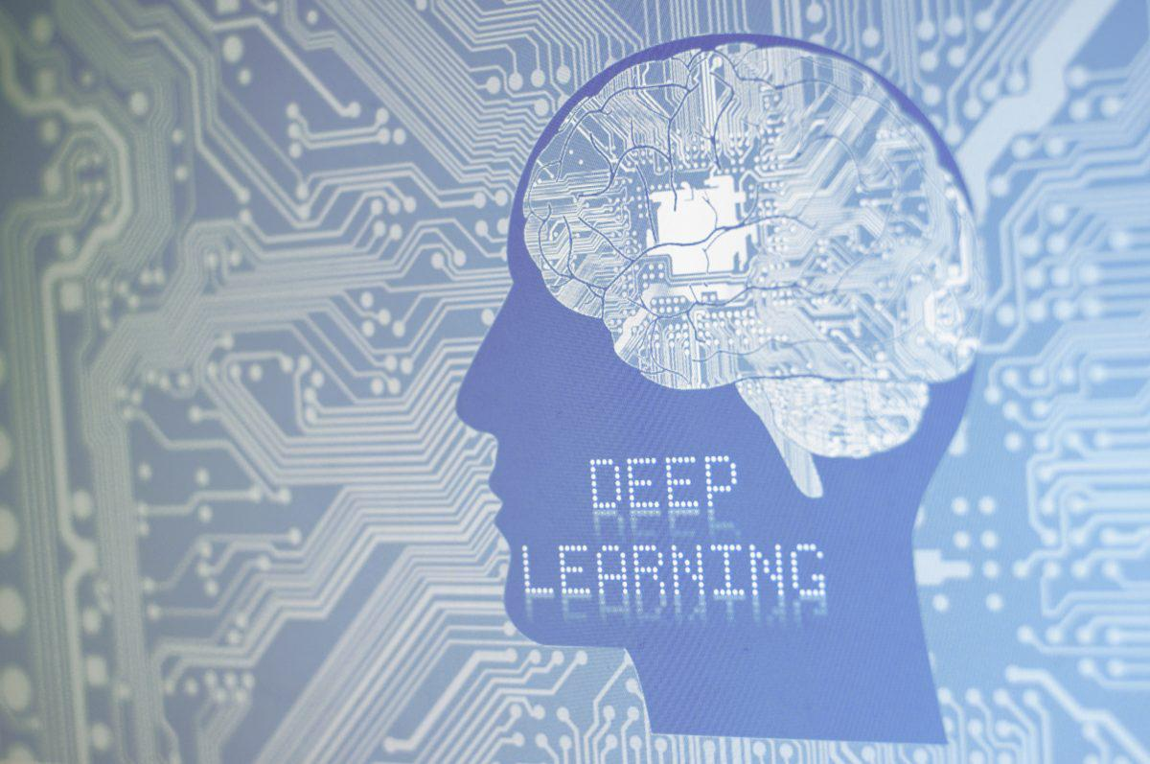
What is Deep Learning
Deep learning is an artificial intelligence (AI) function that imitates the workings of the human brain in processing data and creating patterns for use in decision making. Deep learning is a subset of machine learning in artificial intelligence that has networks capable of learning unsupervised from data that is unstructured or unlabeled. Also known as deep neural learning or deep neural network.
https://www.investopedia.com/terms/d/deep-learning.asp

Slide 25
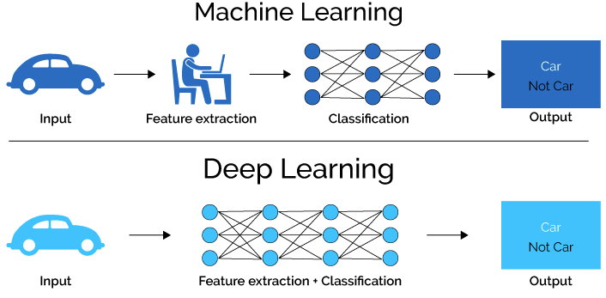
ML vs DL
https://lawtomated.com/a-i-technical-machine-vs-deep-learning/

Slide 26
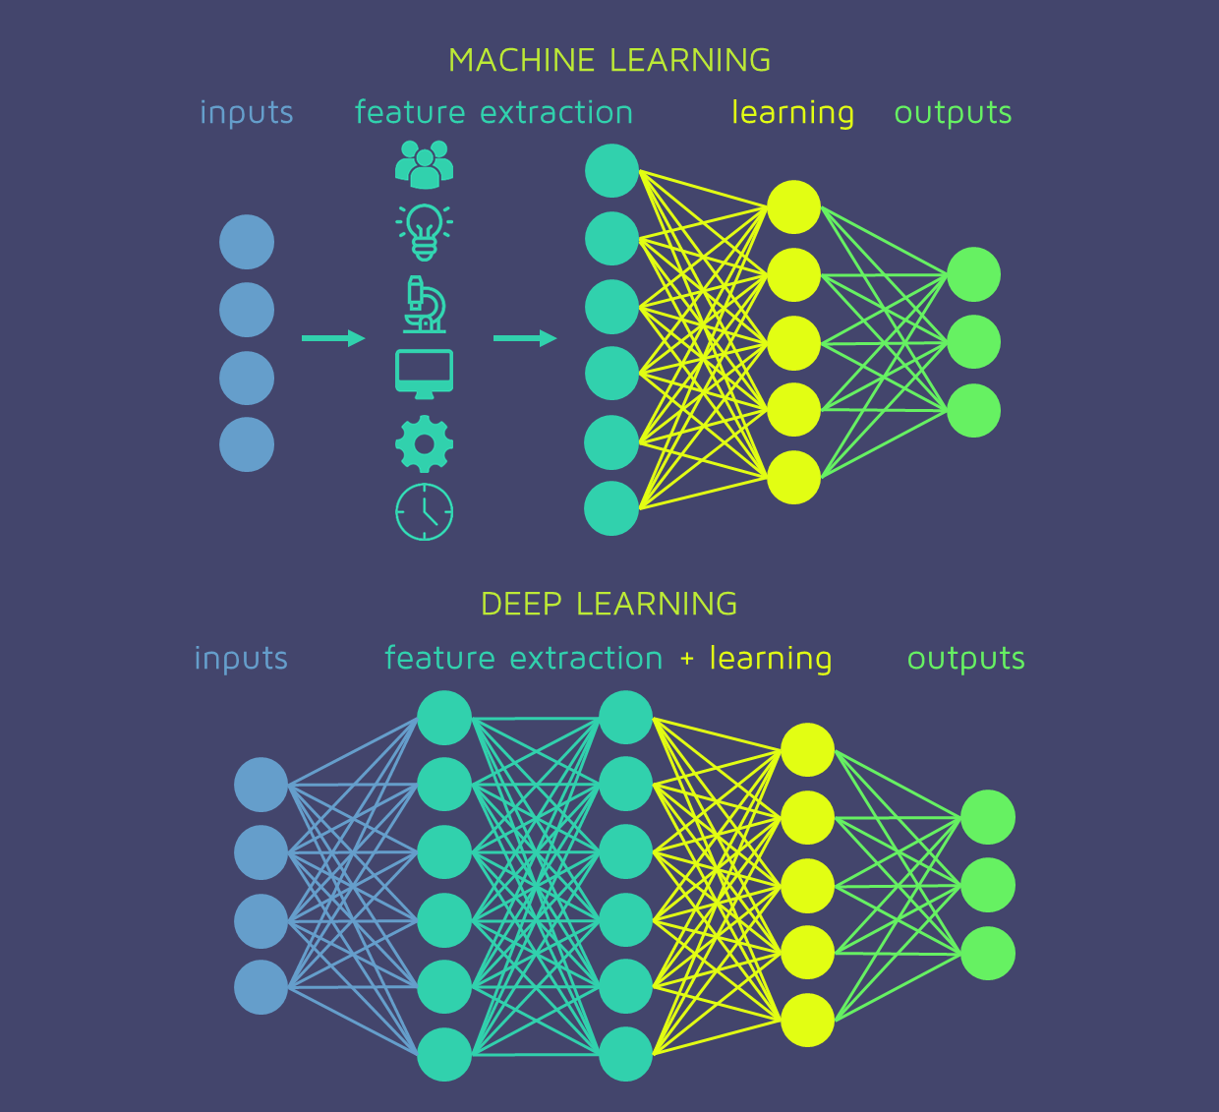
ML vs DL (Another Example)
https://quantdare.com/what-is-the-difference-between-deep-learning-and-machine-learning/

Slide 27
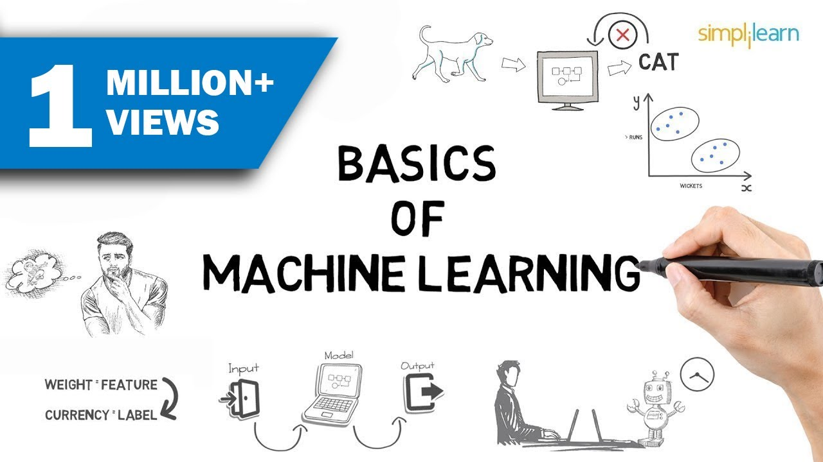
Machine Learning Basics (Video)
https://www.youtube.com/watch?v=ukzFI9rgwfU

Slide 28
Chapter 2
Fundamentals of Market Segmentation

Slide 29
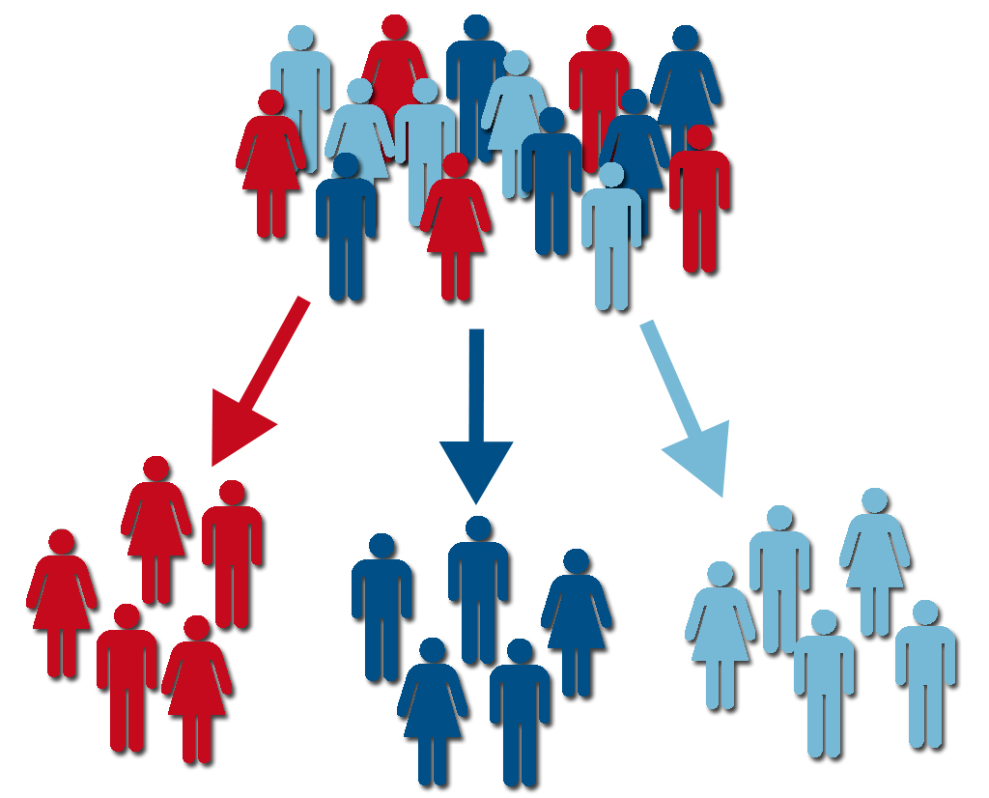
Market Segmentation
Statistically segment the customer groups such as age, income, sex, geographic locations etc.
Based on the given parameters one must perform market segmentation by recognizing distinct and perceptible subgroups of people who might be more receptive to a form of advertising or more likely to purchase a certain product
A segment is typically a cluster of customer observations to make the strategic decision on how to up-sell and cross-sell entities based on user need and wants

Slide 30
The need for Market Segmentation
The companies cannot target each customer but rather it apportions customer based on their preferences to target individual clusters by positioning themselves in a unique segment.
A firm might want to segregate customer based on their price sensitivity, quality of product and brand loyalty.
The resulting variables measured through a Likert scale, the higher value signifies the greater inclination towards price sensitivity, quality of product and brand loyalty whereas a low value confers to lower intensity.

Slide 31
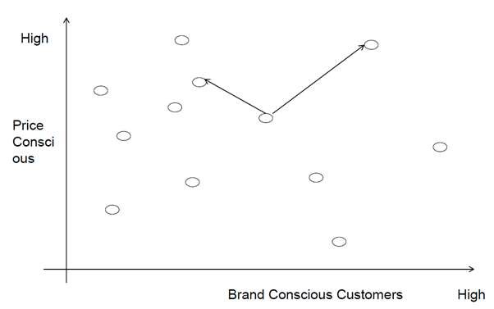
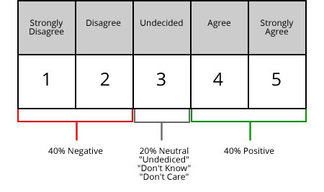
Market Segmentation

Slide 32


Market Segmentation Case Study

Slide 33
Case Study: DELL
Dell mainly uses customer segmentation in its market strategy along with the product segmentation where it is targeting several market segments and designing separate products or offers for them.
On one hand, geographically, Dell has segmented the market into the US/Americas, EMEA and Asia Pacific-Japan where each area has different pricing and marketing strategies.
On the other hand, demographically, there is no age, gender or race bias but income, occupation, and education play a role in deciding the customer needs and hence the product offer.

Slide 34
Case Study: DELL
Dell targets two classes of customers based on relationship customer and the transactional customer.
Relationship-based customers are corporations, government, and education sector that shares a substantial portion of the profit.
On the other hand, traditional customers are price-sensitive looking for low cost, more reliable, quality service and added value products.

Slide 35
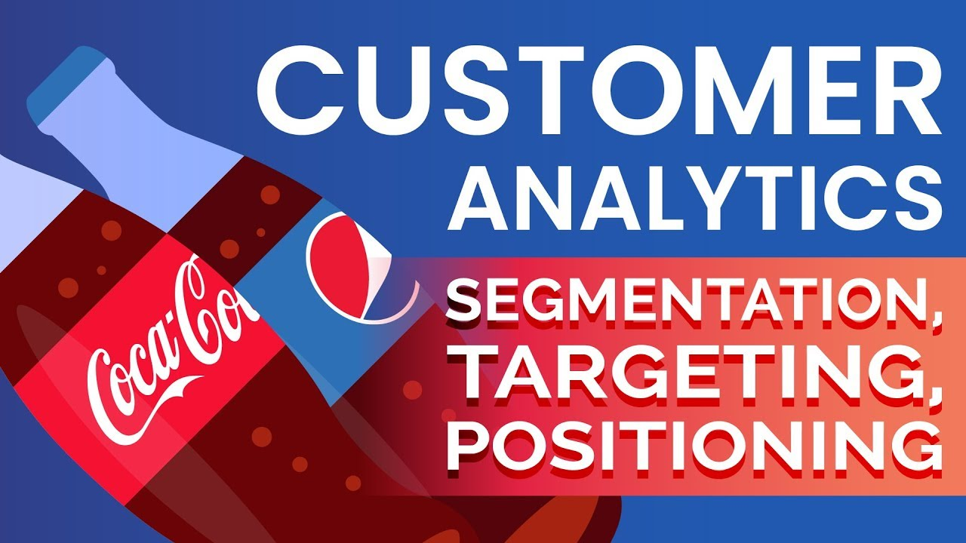
CUSTOMER ANALYTICS WITH DATA SCIENCE
https://www.youtube.com/watch?v=Fij1aBcl_Ts

Slide 36
Chapter 3
K-means Clustering algorithm for segmentation

Slide 37
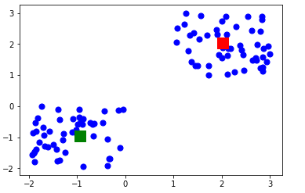
What is K-Means Clustering ?
K-means clustering is one of the simplest and popular unsupervised machine learning algorithms.
Typically, unsupervised algorithms make inferences from datasets using only input vectors without referring to known, or labelled, outcomes.
Output of a K-Means Clustering
https://towardsdatascience.com/understanding-k-means-clustering-in-machine-learning-6a6e67336aa1

Slide 38

K-Means Clustering Illustrated & Simplified
https://medium.com/@luigi.fiori.lf0303/k-means-clustering-using-python-db57415d26e6

Slide 39
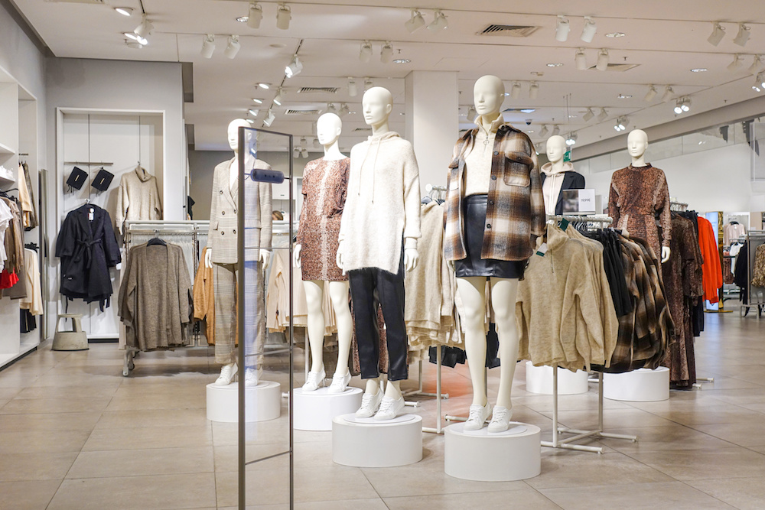
K-Means Clustering
Characteristics within the clusters will be homogeneous while maximising the differences between the groups
Example: A fashion retailer “Y” is interested to understand different segments of customers with a view to launch a social media campaign. How can we go about it?
If we are to cluster customers, what factors of interest to consider? – what data to collect?
How to apply k-means clustering to this set of data?

Slide 40
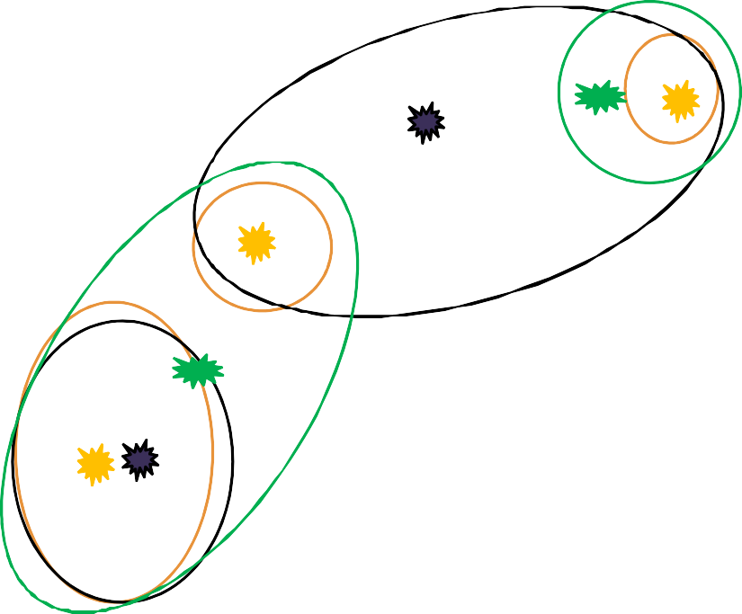
K-Means Clustering Example
0.9
1. How many clusters are here?
Percentage of branded products per shop
D
0.8
0.7
0.6
J
E
0.5
I
0.4
B
0.3
G
0.2
C
0.1
H A
F
0
0
10
20 30
40
50
60
Price paid per item

Slide 41
K-Means Clustering Example
0.9
1. How many clusters are here? 7 Clusters
Percentage of branded products per shop
D
0.8
0.7
0.6
J
E
0.5
I
0.4
B
0.3
G
0.2
C
0.1
H A
F
0
0
10
20 30
40
50
60
Price paid per item

Slide 42
K-Means Clustering Example
0.9
D
0.8
Percentage of branded products per shop
10
0.7
9
6
0.6
J
E
8
I
0.5
B
0.4
3
0.3
₃ G
2 C
0.2
4 45
0.1
0
H A
F
0
10
20 30
40
50
60
Price paid per item

Slide 43
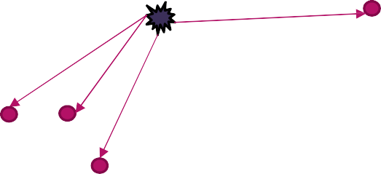
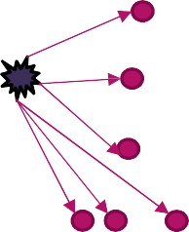
K-Means Clustering Example
0.9
D
0.8
Percentage of branded products per shop
10
0.7
9
6
J
E
8
Total distance = 10+9+6+8 = 33
0.6
I
0.5
B
0.4
3
0.3
₃ G
2 C
0.2
4 45
Total distance = 3+3+2+5+4+4 = 21
0.1
0
H A
F
0
10
20 30
40
50
60
Price paid per item

Slide 44
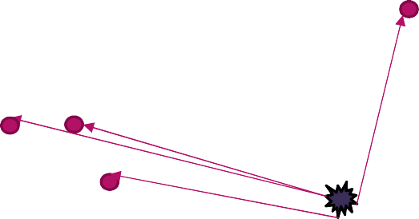
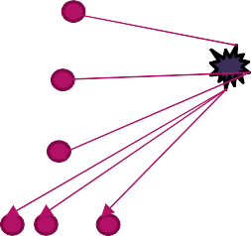
K-Means Clustering Example
0.9
Percentage of branded products per shop
D
0.8
0.7
0.6
J
E
I
Total distance = 12+11+9+8 = 40
0.5
0.4
B
0.3
G
0.2
C
Total distance = 3+3+4+6+8+8 = 32
0.1
H A
F
0
0
10
20 30
40
50
60
Price paid per item

Slide 45
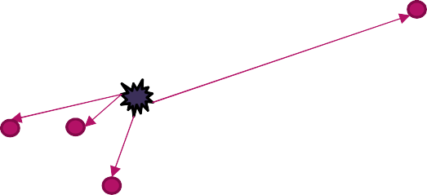
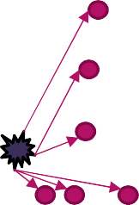
K-Means Clustering Example
0.9
D
0.8
0.7
Percentage of branded products per shop
0.6
J
E
Total distance = 3+2+3+14= 22
0.5
B
0.4
G
0.3
C
0.2
I
H A
F
Total distance = 24
0.1
0
0
10
20 30
40
50
60
Price paid per item

Slide 46
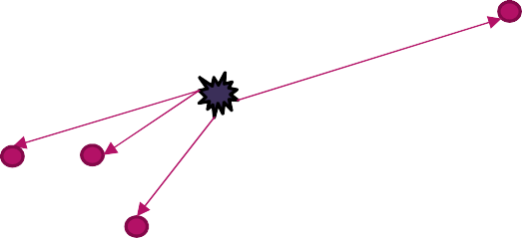

K-Means Clustering Example
0.9
D
0.8
0.7
Percentage of branded products per shop
0.6
J
E
Total distance = 20
0.5
I
0.4
B
0.3
G
0.2
C
H A
F
Total distance = 18
0.1
0
0
10
20 30
40
50
60
Price paid per item

Slide 47
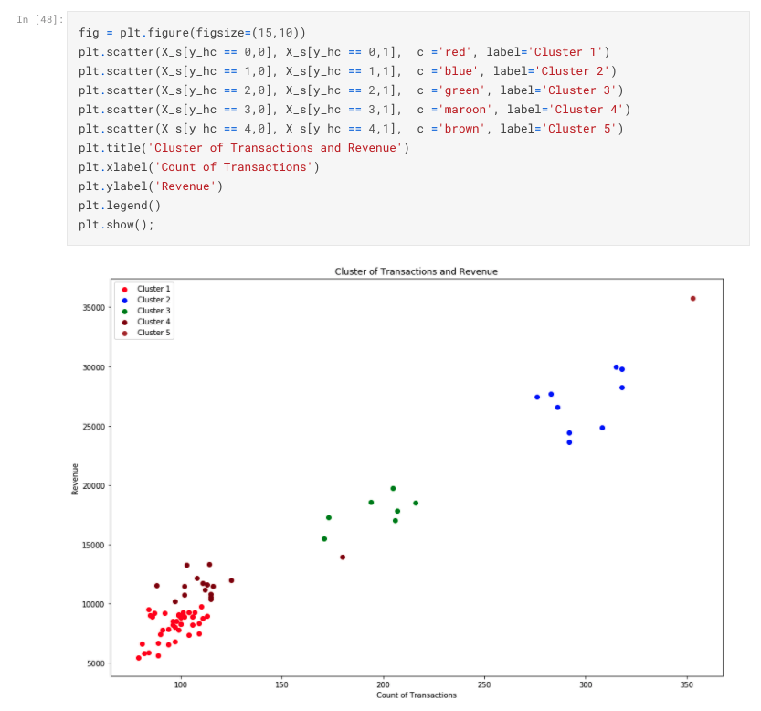
K-Means Clustering
We Are going to view a raw dataset that can be prepared as a K-Means Clustering https://www.kaggle.com/seetzz/market-segmentation
Here is an example of an individual which have prepared the data analysis. https://www.kaggle.com/rajashri/market-segmentation

Slide 48
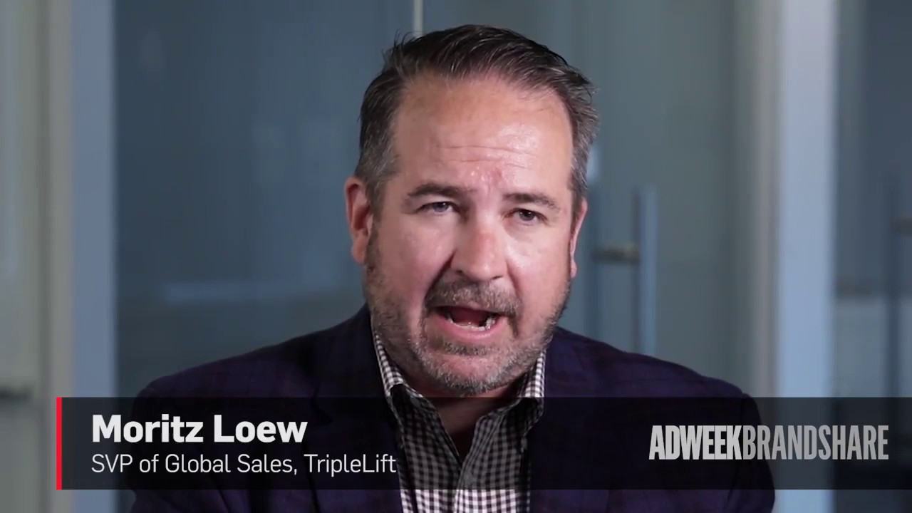
AI IN Marketing
https://www.youtube.com/watch?v=T9EIyGNBR1w

Slide 49
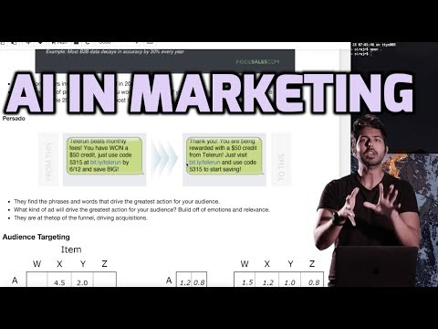
AI IN Marketing
https://www.youtube.com/watch?v=FYMjXD3G__Y

Slide 50
Chapter 4
Marketing Mix Modelling

Slide 51
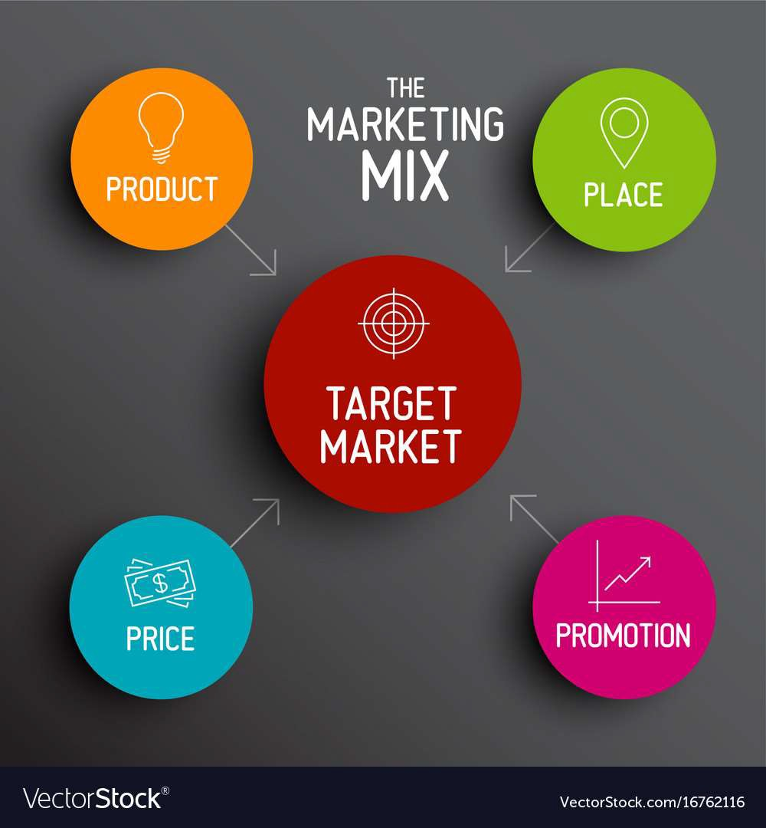
Marketing Mix
Delivering the right product at the right time and at the right price
The marketing mix refers to the set of actions, or tactics, that a company uses to promote its brand or product in the market.
The 4Ps / 7Ps helps companies to review and define key issues that affect the marketing of its products and services and is often now referred to as the 7Ps framework for the digital marketing mix.

Slide 52
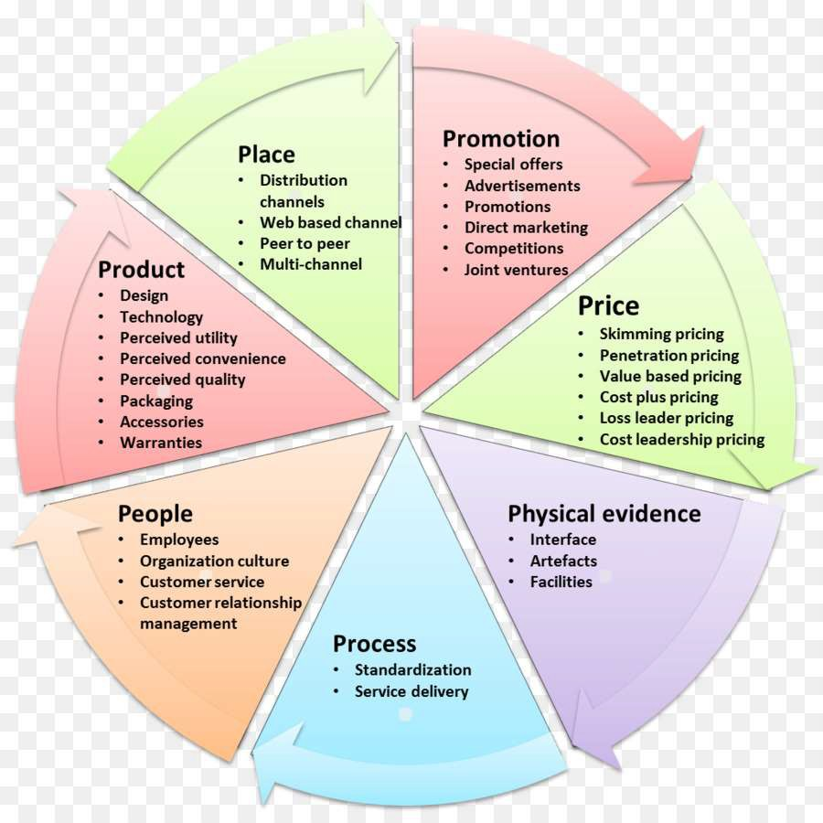
7P’s of Marketing Mix
All the elements of the marketing mix influence each other. They make up the business plan for a company and handled right, can give it great success.

Slide 53
Marketing Mix Modelling
Market Mix Modeling (MMM) is where we carry out data analysis with the aim to understand and find the optimal mix of the Ps.
The purpose of using MMM is to understand how much each marketing input contributes to sales, and how much to spend on each marketing input (Return on Investment).
MMM uses the Regression analysis to extract key information/insights.

Slide 54
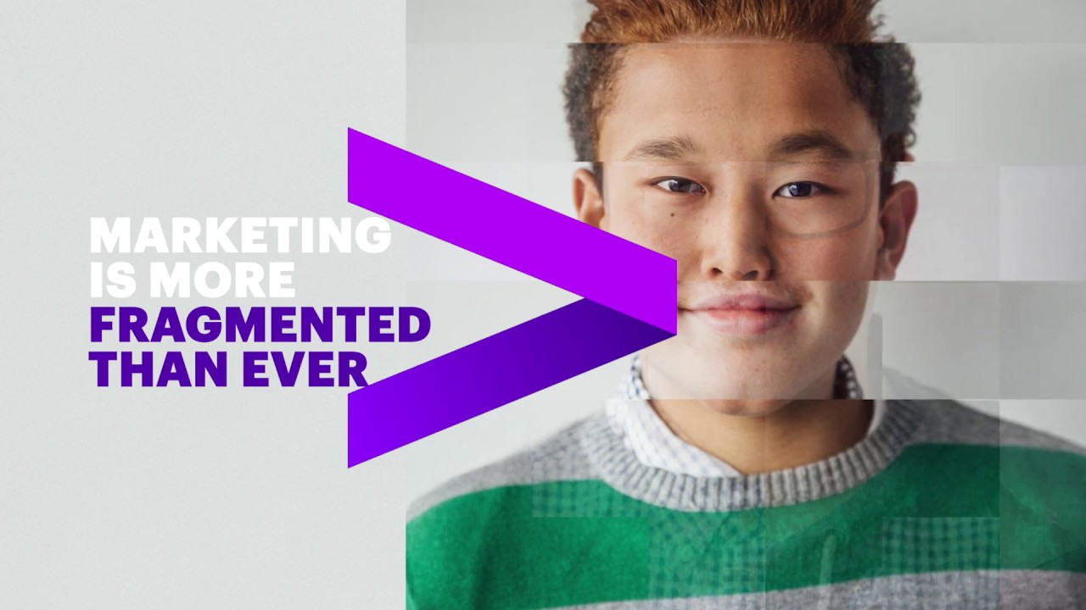
Marketing Mix Modelling
https://www.youtube.com/watch?v=MJOpi0TAKew

Slide 55
Chapter 5
Regression for Marketing Mix Modelling

Slide 56
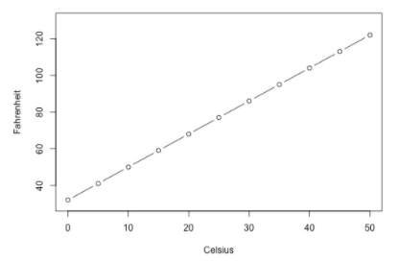
What is a simple linear regression ?
Simple linear regression is a statistical method that allows us to summarize and study relationships between two continuous (quantitative) variables:
One variable, denoted x, is regarded as the predictor, explanatory, or independent variable.
The other variable, denoted y, is regarded as the response, outcome, or dependent variable.
It is basically your y = m(x) + c formula which you have learnt in your secondary school days !
We can use linear regression to evaluate what should be the current Fahrenheit based on the current Celsius value.
https://online.stat.psu.edu/stat462/node/91/

Slide 57
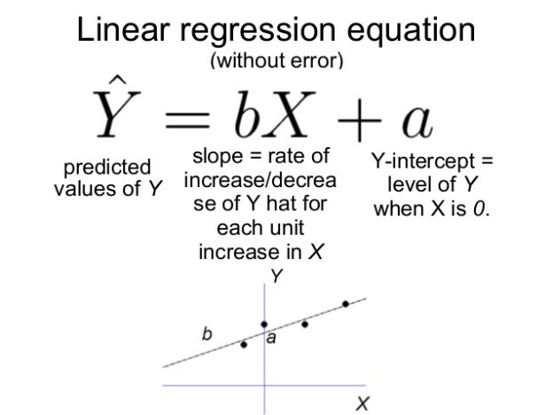
Formula for linear regression
Do not worry.
We will not need to use this formula in this course while this is the formula to use to evaluate a linear regression equation.

Slide 58
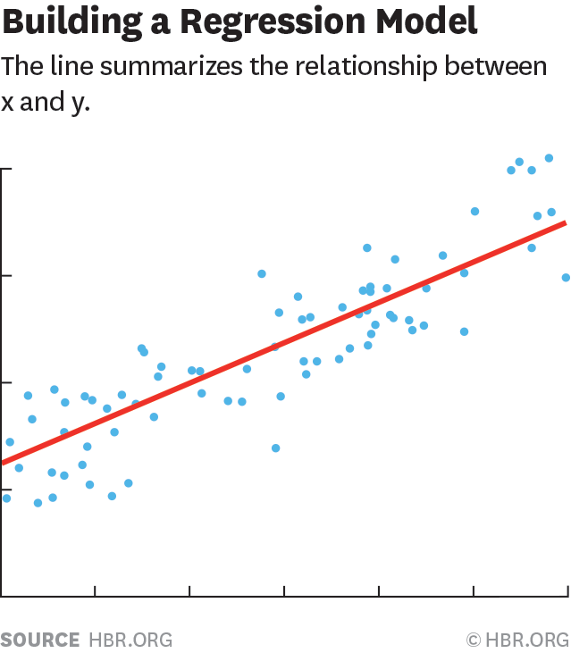
Regression Analysis
Regression analysis is a statistical tool used for the investigation of relationships between variables.
There are two basic types of regression:
1. Simple regression analysis: estimate the relationship between a dependent variable and a single independent variable; for example, the relationship between crop yields and rainfall.
2. Multiple regression analysis: Used to estimate the relationship between a dependent variable and two or more independent variables; for example, the relationship between the salaries of employees and their experience and education.

Slide 59
Regression Analysis: Running Example
A company “X” markets its products on Television, social media, radio and on news papers. It now wants to see, if they can predict the amount of sales using the expenditure on these channels .
They have collected a dataset for the expenditure and sales for each week during the last 4 years.
Social media,’00
Sales, ‘0000
TV ‘00
Radio,’00
Newspaper, ‘00
1 | 230.1 | 37.8 | 25.3 | 69.2 | 22.1
2 | 44.5 | 39.3 | 24.1 | 45.1 | 10.4
3 | 17.2 | 45.9 | 8.7 | 69.3 | 9.3
4 | 151.5 | 41.3 | 57.5 | 58.5 | 18.5
5 | 180.8 | 10.8 | 120.2 | 58.4 | 12.9
6 | 8.7 | 48.9 | 8.6 | 75 | 7.2
7 | 57.5 | 32.8 | 24.2 | 23.5 | 11.8
8 | 120.2 | 19.6 | 18.05 | 11.6 | 13.2
9 | 8.6 | 2.1 | 5.15 | 1 | 4.8
10 | 199.8 | 2.6 | 14.9 | 21.2 | 10.6
11 | 66.1 | 5.8 | 63.05 | 24.2 | 8.6
12 | 214.7 | 24 | 69.8 | 4 | 17.4

Slide 60
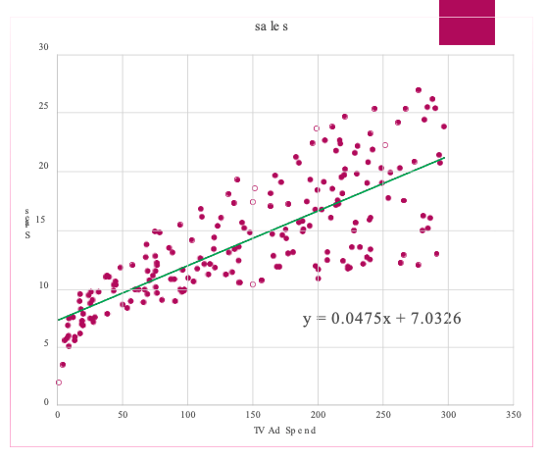
Single Regression
Find the relationship between social media spend and sales
X Axis: Sales
YAxis: Tv AD Spend

Slide 61
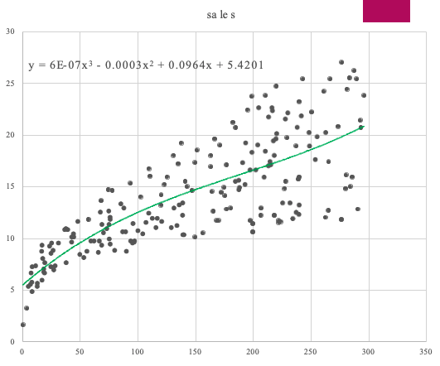
Single Regression
You may opt for a complex model

Slide 62
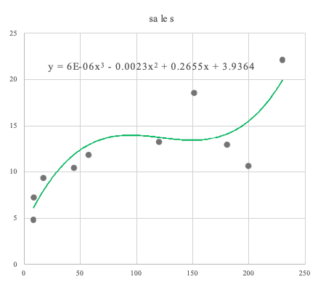
Single Regression
You may opt for a complex model
However, to go for a complex model you need to have enough data!

Slide 63
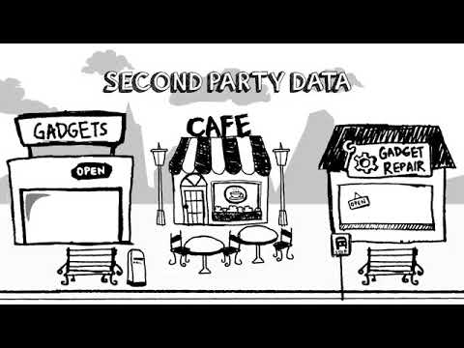
The need for big data in marketing
https://www.youtube.com/watch?v=kblH-9QrRzU

Slide 64
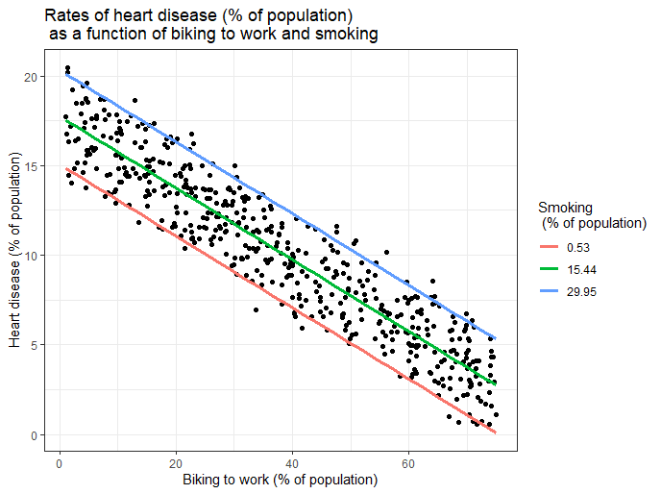
Multiple Linear Regression
What Is Multiple Linear Regression (MLR)?
Multiple linear regression (MLR), also known simply as multiple regression, is a statistical technique that uses several explanatory variables to predict the outcome of a response variable. The goal of multiple linear regression (MLR) is to model the linear relationship between the explanatory (independent) variables and response (dependent) variable.
https://www.investopedia.com/terms/m/mlr.asp

Slide 65
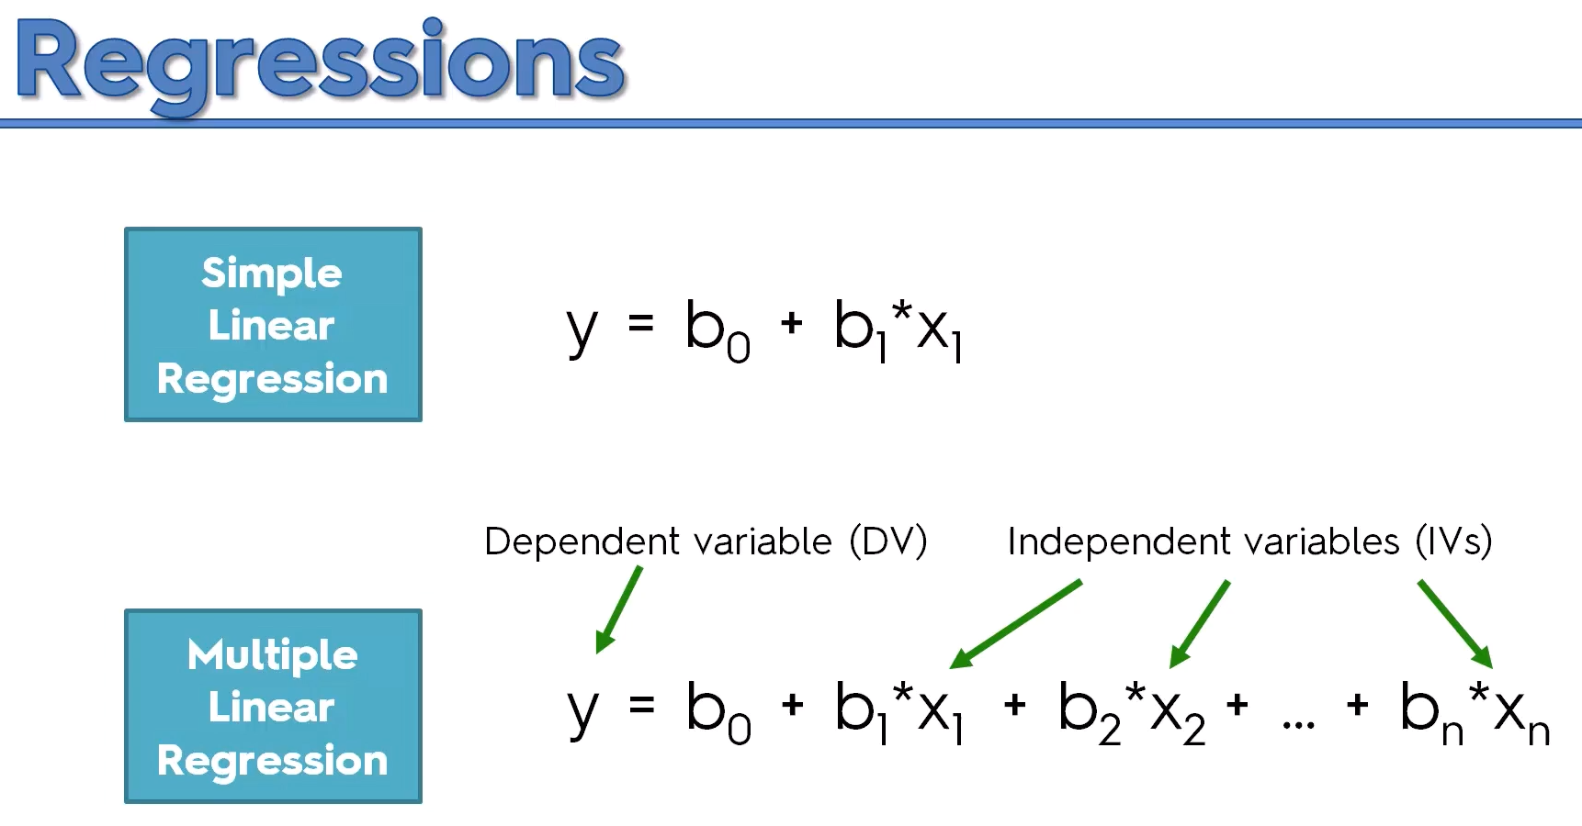
Formula for multiple linear regression
Do not worry.
We will not need to use this formula too.
https://medium.com/@manjabogicevic/multiple-linear-regression-using-python-b99754591ac0

Slide 66
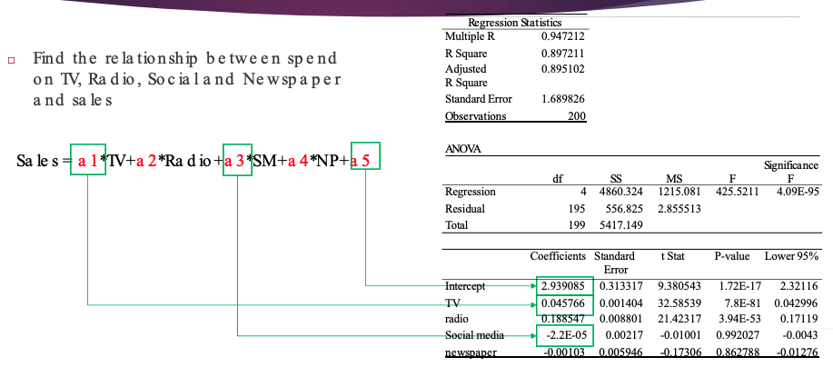
Multiple Regression

Slide 67
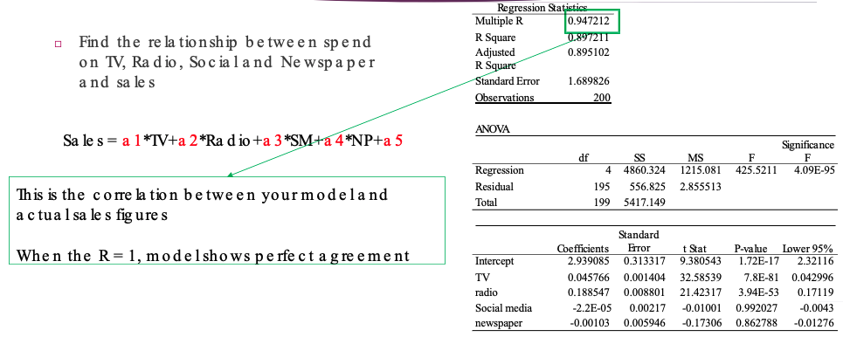
Multiple Regression

Slide 68
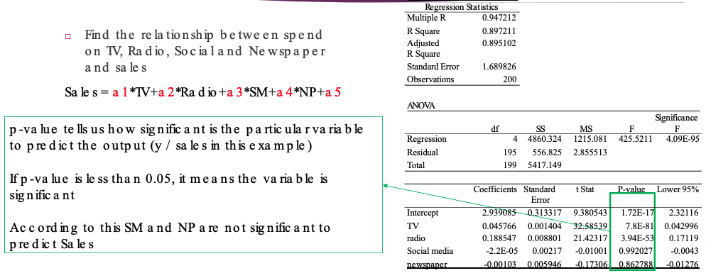
Multiple Regression

Slide 69
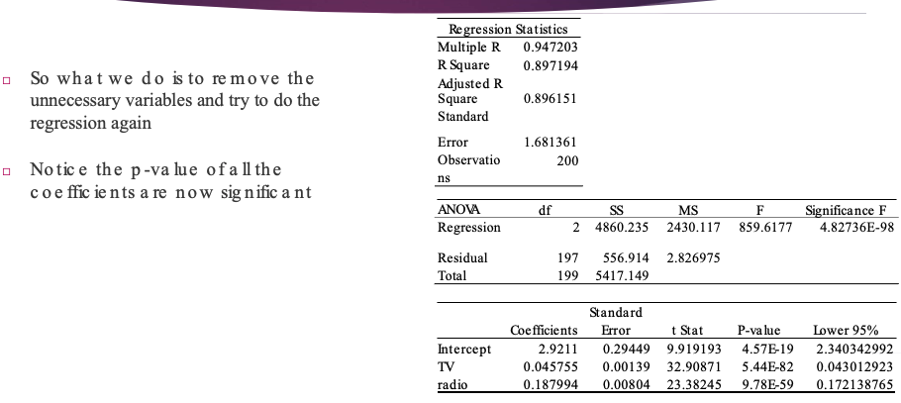
Multiple Regression

Slide 70

Sales Estimation Using Linear Regression
https://www.youtube.com/watch?v=ZPPiZvvpU6s

Slide 71
Further Reading
https://www.themarketingtechnologist.co/calculating-ad-stocks-in-a-fast- and-readable-way-in-python/
https://rstudio-pubs- static.s3.amazonaws.com/294627_5f7e9a449b6c442e806a4743f1b4f8a7.html
http://experimentswithdatascience.blogspot.com/2018/01/marketing-mix- modeling-sales-driver.html
https://www.coursera.org/lecture/uva-darden-market- analytics/marketing-mix-models-XCCSf
https://sites.google.com/site/2015pcsu/data-science/marketing-mix- modeling-to-find-the-best-advertising-route

Slide 72
Chapter 6
Demand Forecasting and time series modelling

Slide 73

Time Series Analysis
Time series is a set of observations organized in time
Time series forecasting thus can be termed as the act of predicting the future by understanding the past
https://corporatefinanceinstitute.com/resources/knowledge/finance/time-series-data-analysis/

Slide 74

Examples of Time Series
Sales per week, Market shares per month
Estimated Brand loyalty
Social media impressions over time
The price evolution over the last few years
Historically-observed advertising-spending patterns

Slide 75

Component of Time Series
A time series is affected by four components
Trend: General tendency over a long period of time
Seasonal: fluctuations within a year, due to climate and weather conditions, customs, traditional habits
Cyclical: medium term trends, The duration of a cycle extends over longer period of time, usually two or more years.
Irregular: unpredictable influences, which are not regular and also do not repeat in a particular pattern. These variations are caused by incidences such as war, strike, earthquake, flood, revolution, etc

Slide 76

Component of Time Series
A time series can be decomposed as the addition of the components

Slide 77


Visualizing Time Series
Understanding follower growth, and learning anomalies in audience behaviour
E.g. Facebook likes
Tweets or clicks
Comments
Understand social media impressions
Number of times your content was displayed
https://www.socialmediaexaminer.com/5-ways-to-analyze-social-media-marketing-performance/

Slide 78

Visualizing Time Series
To measure brand reputation and overall sentiments: Example brand24.com

Slide 79

Time Series Modelling
The main aim of time series modelling is to carefully collect and rigorously study the past observations of a time series to develop an appropriate model which describes the inherent structure of the series.
This model is then used to generate future values for the series, i.e. to make forecasts.
Forecast of GDP
https://corporatefinanceinstitute.com/resources/knowledge/finance/time-series-data-analysis/

Slide 80

Time Series Modelling is not used much in marketing – 2000
Marketing scientists' lack of training in TS methods and access to user- friendly TS software
A resistance to data-driven approaches in model specification
A lack of adequate data sources
The absence of a substantive marketing area where TS modelling was adopted as primary research tool.

Slide 81









Moving Average with Trend Line
Google Stock price
1300
 |  |  |  |  | Ser | ies1
 |  |  |  |  | 2 Lin | per. Mov. ear (Seri | Avg. (Se es1) | ries1)
1250
1200
1150
1100
1050
1000
950
900
19/07/2018
08/08/2018 28/08/2018 17/09/2018 07/10/2018 27/10/2018 16/11/2018
06/12/2018
26/12/2018 15/01/2019

Slide 82

Moving Average

Slide 83

Moving Average

Slide 84

Moving Average

Slide 85
Auto-Regression
Google Stock Price
1200
 |  |  |  |  | x1 x2 |  | x3
 |  |  |  |  |  |  | 10/02/2018
 |  |  |  |  |  |  |  | ?
1180
1160
1140
1120
1100
1080
1060
1040
1020
1000
980
10/01/2018
15/01/2018
20/01/2018
25/01/2018
30/01/2018
04/02/2018
09/02/2018
14/02/2018

Slide 86
Auto-Regression
Google Stock Price
1200
 |  |  |  |  | x1 x2 |  | x3
 |  |  |  |  |  |  | 10/02/2018
 |  |  |  |  |  |  |  | ?
1180
1160
1140
1120
1100
1080
1060
1040
1020
1000
980
10/01/2018
15/01/2018
20/01/2018
25/01/2018
30/01/2018
04/02/2018
09/02/2018
14/02/2018

Slide 87
Auto-Regression
Google Stock Price
1200
1180
x1 x2 x3
1160
1140
1120
1100
1080
y = a1*x1 + a2*x2 + a3*x3 + a4
1060
1040
y
To find a1, a2, a3 and a4, we need example data.
1020
Where to find them?
1000
980
10/01/2018
15/01/2018
20/01/2018
25/01/2018
30/01/2018
04/02/2018
09/02/2018
14/02/2018

Slide 88
Auto-Regression
x1 x2 x3 y
x1 x2 x3 y
x1 x2 x3 y
.
1200
1180
1160
1140
1120
1100
1080
1060
1040
1020
1000
980
10/01/2018
15/01/2018
20/01/2018
25/01/2018
30/01/2018
04/02/2018
09/02/2018
14/02/2018

Slide 89
Auto-Regression
Google Stock Price
1200
1180
x1 x2 x3
1160
1140
1120
1100
1080
y = a1*x1 + a2*x2 + a3*x3 + a4
1060
1040
y
We find a1, a2, a3 and a4, from sample data extracted from the time series
1020
1000
Once we have the coefficients, we can use the model to predict y
15/01/2018 20/01/2018 25/01/2018 30/01/2018 04/02/2018
980
10/01/2018
09/02/2018
14/02/2018

Slide 90
Predicting Time series with ARMA / ARIMA
ARMA – is a combination of Auto regression and Moving Average
Prediction = m1* Auto Regression + m2* Moving Average + m3
ARIMA – Auto-regressive integrated Moving Average
Prediction = m1* Auto Regression + m2* Moving Average + m3* Differences between time points + m4

Slide 91

Auto Regressive Model
https://www.youtube.com/watch?v=5-2C4eO4cPQ

Slide 92
Further Reading
https://www.sciencedirect.com/science/article/pii/S0167811600000148
https://arxiv.org/ftp/arxiv/papers/1302/1302.6613.pdf

Slide 93
Datasets to Experiment
http://archive.ics.uci.edu/ml/datasets/Bank+Marketing
http://archive.ics.uci.edu/ml/datasets/Facebook+Live+Sellers+in+Thailand
https://experimentswithdatascience.blogspot.com/2017/12/demand- forecastingtime-series-smoothing.html

Slide 94
Chapter 7
Customer behaviour analysis and classification

Slide 95

Customer Churn Analysis
Customer churn analysis refers to the customer attrition rate in a company. This analysis helps companies identify the cause of the churn and implement effective strategies for retention.
An example would be reducing customer churn by 5% can increase profits 25-125%.
Statistics show that acquiring new customers can cost five times more than retaining existing customers.
https://www.profitwell.com/customer-churn/analysis

Slide 96

What Customer Churn Analysis do ?
Gathers available customer behavior, transactions, demographics data and usage pattern
Converts structured and unstructured data/information into meaningful insights
Utilizes these insights to predict customers who are likely to churn
Identifies the causes for churn and works to resolve those issues

Slide 97

Analyzing Customer Behavior
If we are going to keep the products / services relevant to the customer, we need to know what they want to see. That means we need to analyse the customer behaviour.
Converts structured and unstructured data/information into meaningful insights
Utilizes these insights to predict customers who are likely to churn
Identifies the causes for churn and works to resolve those issues

Slide 98

Analyzing Customer Behavior
If we are going to keep the products / services relevant to the customer, we need to know what they want to see. That means we need to analyse the customer behaviour.

Slide 99
Analyzing Customer Behavior
Here are some metrics you should look out for.
Dwell time
Types of purchases
Number of returning customers
Website traffic patterns

Slide 100
Analyzing Customer Behavior
Here are some metrics you should look out for.
Dwell time
Types of purchases
Number of returning customers
Website traffic patterns

Slide 101

Analyzing Customer Behavior
DWELL TIME
This is how long your customers spend on your website. Theoretically, the longer the dwell time, the more likely a customer is to make a purchase (although you can still get customers who pop onto your website, search for a specific item and purchase within minutes).
One important factor is your website design. Aim to design a great eCommerce website experience. This can lead to a streamlined, excellent user experience and a greater chance that a customer will buy something from you.
Just think: Are you more likely to purchase something from a site that’s confusing and difficult to navigate or one that’s refreshingly user-friendly?

Slide 102

Analyzing Customer Behavior
TYPES OF PURCHASES
What kind of things are your customers buying? And what kind of people are they? By this, we mean their demographic and interests.
When you know which products/services are typically bought by what demographic, it suddenly becomes much easier to tailor your offerings. For example, you can tweak your product information to make it more detailed and ensure the messaging resonates with a specific demographic.
https://clootrack.com/knowledge_base/types-of-consumer-behavior/

Slide 103

Analyzing Customer Behavior
Number of returning customers
It’s five times more expensive to attract new customers than it is to retain your existing ones. That’s why it’s so important to focus on retaining your current customers. It starts with ensuring they’re satisfied (though delighted is even better).
A happy, satisfied customer is more likely to turn into a loyal one who consistently turns to your brand, trusting you to provide them with the products/services they need.
https://blogs.constantcontact.com/repeat-customers/

Slide 104

Analyzing Customer Behavior
Website traffic patterns
If you were monitoring traffic patterns in-store, that would mean looking at how your customers are moving across your shop floor. You’d then use that knowledge to tweak your store layout. You want your customers to notice and move to your best merchandise soon after entering.
We will explore in the next slide in detail metrics which can be used to analyse website traffic patterns.

Slide 105

Analyzing Customer Behavior - Website Traffic Patterns
Heatmaps
This is similar to monitoring traffic patterns in-store. Web analytics tools, such as Google Analytics, allow you to view how your customers navigate your website. Or in other words, a heatmap. This can help you optimise your website and ensure it’s as simplified and user-friendly as it can be.
Heatmap analysis of the store

Slide 106

Analyzing Customer Behavior - Website Traffic Patterns
No Of Active Users
Knowing what time your customers typically come online can be very valuable. For instance, when you know what time the majority of your customers visit your website (even better if you can map this to a demographic), you can tailor your online content to them.
They could be presented with different offers and promotions depending on the time of the day. Combine this with additional insights like whether they’re a returning customer, their past purchases and search history and you can really boost sales.
https://techcrunch.com/2017/06/27/facebook-2-billion-users/

Slide 107

Analyzing Customer Behavior - Website Traffic Patterns
Pages visited
In addition to seeing the order of the pages your customers typically visit via heatmaps, it’s useful if you can also see which pages are the most clicked on. This indicates which of your pages are the most popular.
With this information, you can:
Analyse why those pages are so popular
See what kind of pages they are - e.g. product/service page (and if so, for what products/services?), a page about your company, etc
Track what pages customers viewed before and after these pages
See whether there’s a recurring theme between the most popular pages - e.g. whether they all have a video embedded or they all mention a particular product/service

Slide 108

Customer Journey
https://www.smartinsights.com/digital-marketing-strategy/10-marketing-trends/

Slide 109

Starbucks Improving Customer Journey using AI
https://www.youtube.com/watch?v=LvrLQMwJsok

Slide 110

Starbucks Improving Customer Journey using AI
https://www.youtube.com/watch?v=7_GpgSpaKTg

